Slide 1
Potential Projects with SHARE
24/09/2020
1st ProPASS ECR Network Meeting
Fabio Franzese
Munich Center for the Economics of Aging
Max-Planck-Institute for Social Law and Social Policy

Slide 2
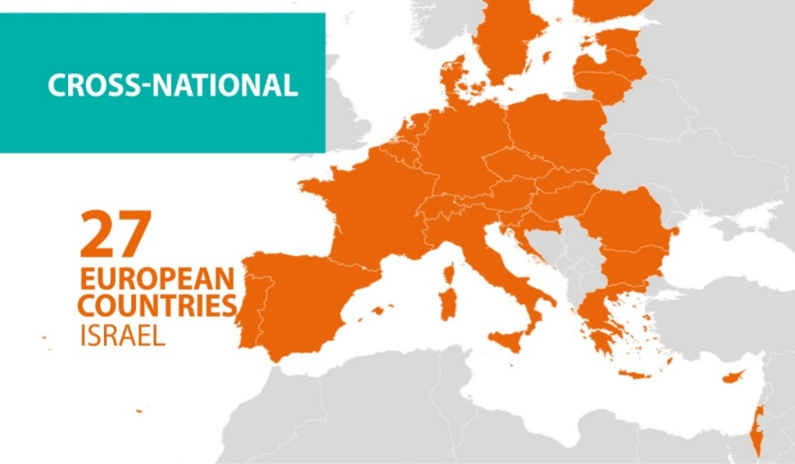
SHARE in a nutshell

Slide 3
SHARE in a nutshell: Questionnaire
Socio-economic status (labor force participation, income, wealth, consumption, pension claims)
Social participation (activities, volunteering, family and social networks, help)
Health (SWB, ADL/IADL, physical performance, cognition, health behaviors, health utilization and insurance coverage)

Slide 4
SHARE Accelerometer Project
Participating countries:
Sweden
Denmark
Germany
Poland
Belgium
France
Czechia
Slovenia
Spain
Italy

Slide 5
SHARE Accelerometer Project
Wave 8
Nov. 2019 – Mar. 2020
10 countries
7 days, free-living, thigh worn accelerometer
Oversampling of older respondents
Aim: Subsample of 200 respondents per country
Achieved: Approx. 840 respondents
Data:
GGIR
Internal release: Oct. 2020
Public release 2021
Notes:
We will have a net sample size of 200 Rs in the main phase. During pre-test, however, we will operate with 5 devices per country. Those devices should ideally be cycled once or twice which should leave us with a number of maximum 20 respondents per country. We will explain the cycling process in a minute.
This means, in the main phase we will have a gross sample of 720 – 760 respondents. During preload they will receive an accelerometer variable which is set to 1 if the respondent has given consent.
Currently, we can only estimate how many respondents actually will give consent for participation.
That is why, for the pre-test we are going to collect consent from all sample members and would like to ask you to cycle the device as often as possible.
The interviewers should inform R that consent does not imply automatic participation in the study, we will explain this in detail in a minute.

Slide 6
Project I
Physical activity & living conditions in old age
alone vs. partner in household
Social network outside of household
Grandparenting
Type/area of housing

Slide 7
Project II
Physical activity & quality of life in old age
CASP-12 scale:
Control
Autonomy
Self-realization
Pleasure

Slide 8
Your Idea?
Combine SHARE accelerometer data
All:
Wave 8
Wave 6
Subsample:
More longitudinal data
Covid study (telephone interview)
SHARELIFE (information on whole lifecourse)
www.share-eric.eu
www.share-datadocutool.org

Slide 9
Projects
PA & living conditions
PA & quality of life
Open for other research questions
Physical functioning
Cognition
Mental health
www.share-eric.eu
www.share-datadocutool.org

Slide 10
contact
franzese@mea.mpisoc.mpg.de

