Slide 1
Development and evaluation of a Surveillance system for Physical Activity, Sedentary behavior & Sleep - SurPASS -
Nidhi Gupta & Andreas Holtermann
National Research Centre for the Working Environment,
Copenhagen, Denmark

Slide 2
Vision
A monitoring system
valid information on physical behaviors
low participant burden easy to use, high hygiene, no sensor returning
low administrative burden cheap in cost, automated analytics, low logistic burden, high data security, low expertise demands
use in large scale surveillance and cohorts
international use

Slide 3
Every second year in Denmark, these questions to about 30.000 working adults in Denmark (part of surveillance)

Slide 4
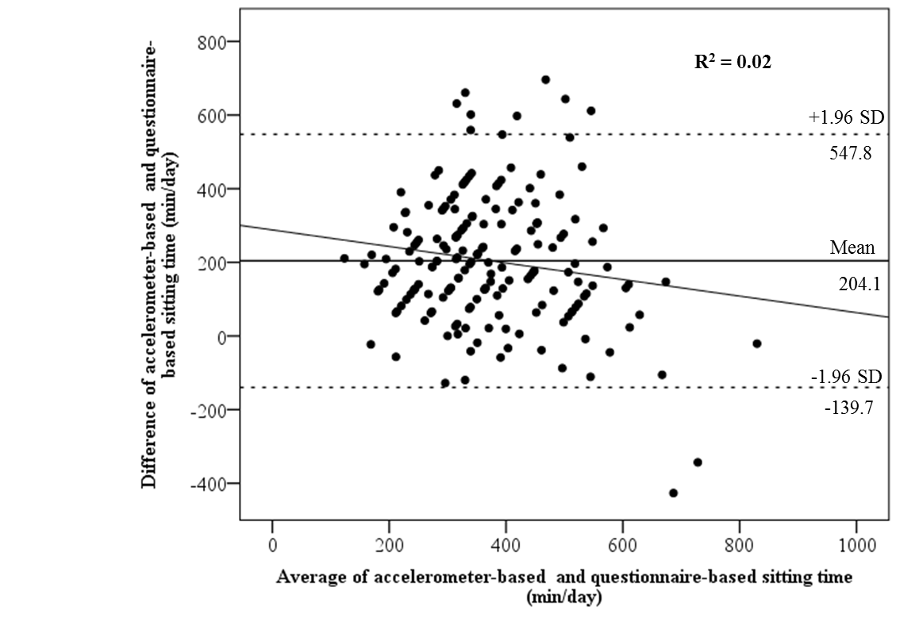
Difference between self-report and technical measurements
Gupta et al BMJ Open, 2017

Slide 5
Example
Large cost
Huge administrative burden and requirements
Some participation burden

Slide 6
Funding for “first step” of the Vision
Surveillance system for Physical Activity, Sedentary behavior & Sleep “SurPASS”
Purpose
to develop and evaluate a low-cost, large-scale, monitoring system for physical behaviors (physical activity, sedentary behavior and sleep) for surveillance of the “adult working population” in Denmark

Slide 7
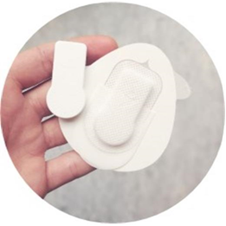
How develop? a low-cost, large-scale, monitoring system for physical behaviors on large scale surveillance and cohorts

Slide 8
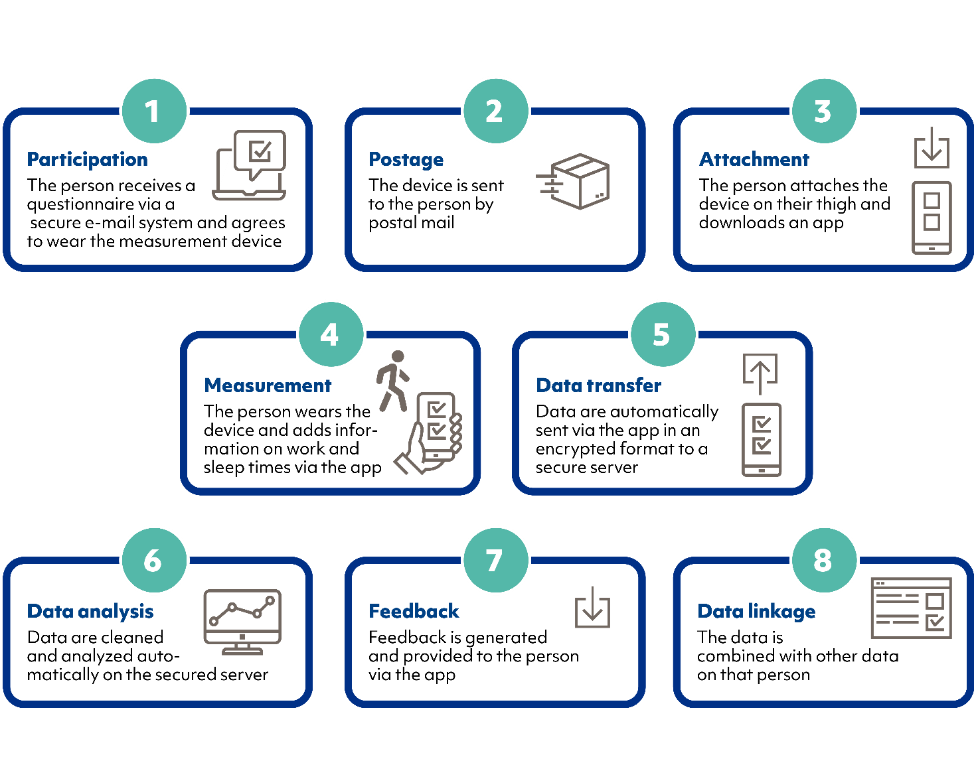
The 8 step process
Participation
Postage
Attachment
Measurement
Data transfer
Data analysis
Feedback
Data linkage

Slide 9
ProPASS & SurPASS – hand in hand
Share much of the same Vision
Same «take on» physical behavior construct, protocols, thigh-worn accelerometer, analyses, data handling...
SurPASS can (if proving succesful) to be a tool facilitating prospective harmonization of cohorts and surveillance internationally

Slide 10
Potential Work Packages for ECRs
Development of the front end (app, interface) and protocols
System automation
Feasibility study
Data security and data handling
Process evaluation at various phases of development
Further development of surveillance system to be used internationally
Development of system for observational cohort studies internationally

